Slide 1


Performance Evaluations
Human Resources/Payroll
Human Resources/Payroll
Revised 06/01/2021

Slide 2
NMHU Performance Evaluation
Learning Objectives
Learn the Performance Evaluation process
Review format for performance assessment
Review goal setting process
Share best practices in communicating performance
Understand the timeline for evaluations and submittal process

Slide 3
NMHU Performance Evaluation
Why Do We Need Performance Evaluations?
A fair and easily understood performance evaluation gives the organization and employees valuable information on what is expected to ensure success
Performance catalyst

Slide 4
NMHU Performance Evaluation
Purpose of Evaluations
To provide employees with feedback about their job performance, leading to increased employee effectiveness
To conform to legal requirements and reduce the potential risks of litigation
To provide a more equitable basis for allocating rewards and penalties based upon each individual’s relative contribution
To increase the organizations capability for identifying talent and utilizing it fully
To identify training and development needs in the organization
To improve communication between an employee and supervisor
To provide information about the organizations’ climate, including strengths and weaknesses

Slide 5
NMHU Performance Evaluation
Performance Management
Performance Evaluation
Ongoing
Prospective
Long term
Progress steps
Planning/goal setting
One time event
Retrospective
Short-term
Correction oriented
Completing form

Slide 6
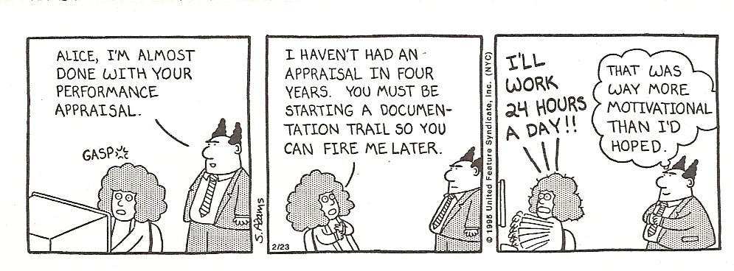
NMHU Performance Evaluation

Slide 7
NMHU Performance Evaluation
Framework for Preparing…
Performance feedback should not be a surprise, but a reflection of ongoing feedback
Accuracy
Specific to the Employee
Take the entire performance period into consideration
Eliminate the fear from the event!
Seek performance input from other departments with who your staff interact

Slide 8
Manager Performance Evaluation Guide
To Access the “Performance Evaluation Form” go to:
www.nmhu.edu click on “staff”; go to left margin click on “Online Documents.”
Under Source All Areas, select “Human Resources.”
In the box below that states Description Contains, type in “FY21 Evaluation”
Click “Display.”

Slide 9
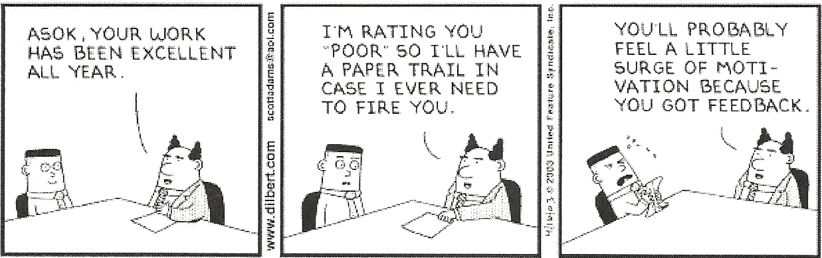
NMHU Performance Evaluation

Slide 10
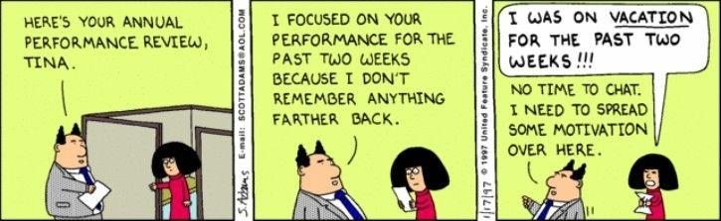
NMHU Performance Evaluation

Slide 11
NMHU Performance Evaluation
Rating Bias
Halo/Horn Effect – rate employees the same on every trait
Central Tendency – lack of rating differentiation between employees
Leniency – avoids honest ratings to avoid conflict
Recency – narrow focus on recent events – (notes throughout the year)
Similarity/Like me – favorable rating to employees who have similar values or interests to the rater
Constancy – rate employees via rank order

Slide 12
NMHU Performance Evaluation
Consider the totality of the employees performance
Make objective statements - not I think or I feel…
Inadequate record keeping – lack of specific examples
Lack of establishing milestones for progress reviews
Legal impact of inflated performance ratings
Maintain clear and open communication channels
Specific comments should avoid any connotations which are connected to: age, race, sex, religion, national origin, veteran, or a specific disability

Slide 13
NMHU Performance Evaluation
Goal Setting
Define and establish specific goals/objectives for the new review period.
Create mutually agreed timelines for progress reports on goals and objectives.
Communicate changes or redirection of goals and objectives in a timely manner.
Ensure alignment of goals
Highlands Strategic Goals
Departmental Strategic Goals
Individual Strategic Goals

Slide 14
Appropriate Goals
Align with those of your corresponding Director or Dean’s operational goals
Represent the outcomes that you can contribute, in your position, toward achievement of department or University mission or goals
Develop your performance and help you grow professionally

Slide 15
A GOAL is a statement of specific work-related achievement to be accomplished within a specified time frame. A routine goal that describes normal work output is also known as a DUTY.
To maintain a satisfied customer base
To implement a reorganized up – to – date filing system
To ensure clean, well – maintained buildings

Slide 16
Three Types of Goals
Routine (Normal Work Output)
  Example: to prepare the monthly Key Statistics Report
Problem Solving (Quality Improvement)
  Example: To improve the readability and format of monthly Key Statistics Report
Innovative (Something New)
  Example: To create a new electronic template for Preparing the monthly Key Statistics report

Slide 17
A goal should be written so that it describes how results are to be obtained, how results are to be measured, and when the work will be done. In other words, define the PERFORMANCE STANDARD.
To ensure clean, well – maintained buildings
To increase the number of square feet cleaned from 4000 to 5000 in one 8 – hour shift with no increase in quality errors.

Slide 18
NMHU Performance Evaluation
Use SMART goal criteria
    Specific- What will the goal accomplish? How and why will it be accomplished?
    Measurable- How will you measure whether or not the goal has been reached (list at least two indicators)?
    Achievable-Is it possible? Have others done it successfully? Do you have the necessary knowledge, skills, abilities, and resources to accomplish the goal? Will meeting the goal challenge you without defeating you?
    Results Focused-What is the reason, purpose, or benefit of accomplishing the goal? What is the result (not activities leading up to the result) of the goal?
    Time-bound-What is the established completion date and does that completion date create a practical sense of urgency?
The concept of writing S.M.A.R.T. goals is very important for accomplishing individual goals, which in turn are linked to department and University goals. It is also critical for ensuring good communication between employees and supervisors so there are no surprises during annual performance evaluations.
Notes:
S - __________________
Concrete
Action verb (“To” + Verb)
M - __________________
Numeric or descriptive measures
Quantity: how many, rate, or volume
Quality: how well, level of accuracy, completeness or
originality
Cost: how much, or cost limits within which employee
must work
Timeliness: by what deadline must results be completed
A - ___________________
“Stretch” but feasible
Sufficiently limited in scope
Within employee’s control and influence
R - ____________________
Measures actual outputs or results, not activities
Results include: products, deliverables, accomplishments
T - ____________________
Target date identified
Interim steps, plan to monitor progress

Slide 19
Writing a Goal or Duty
Chart 1. Developing Standards for Goals and Duties
Goal/Duty
To develop standard operating procedures for administrative staff.
Standard
What: to develop standard operating procedures for administrative staff.
How: to include service standards, scheduling, ordering, and filing functions
Why: to orient new staff and ensure consistency
When: One SOP each quarter

Slide 20
Performance Review
The performance section contains 4 performance objectives and a checkbox for the rating. Performance objective #1 asks the rater to assess the employee’s performance related to a key University priority.
Goal 1 – Support the NMHU mission and priorities by providing academic excellence, academic integration and student success. (Every employee’s position exists to support the University’s mission and priorities and individual performance can be assessed related to the priorities).
-For example: Appraisal for a facilities position – Employee effectively maintains buildings insuring that all mechanical systems are in working order so employees and students have a positive work and learning environment.
-Appraisal for an accounting position – Employee met deadlines for period financial close with accuracy insuring that the institution had timely accurate reports for decision-making.
Goal 2 – Select the most important job responsibility and assess the employee’s performance against that responsibility.
Goal 3 – Select another important responsibility and assess the employee’s performance against that responsibility.
Goal 4 – Assess employee performance related to their teamwork within the department and with other departments who they work closely with to accomplish the department goals.

Slide 21
Presidential and Institutional Targets for University Priorities
Vibrant Campus and University Life:
Campus recreation and intramural sports programs will increase through enhanced programming and staff support as evidenced by local and/or national measures of student satisfaction with campus life.
HU students, staff and faculty will have the opportunity to participate in more, and more meaningful major cultural events as evidenced by local measures of student, staff, and faculty satisfaction.
Community Partnerships:
Increased internship opportunities through community partnerships in Las Vegas and Northern New Mexico.
HU staff will play a more prominent role in community life by virtue of participation on boards and civic organizations.
Technological Advancement and Innovation:
Create and implement a University-wide Technology Plan by 2021.
Acquisition and use of critical software to enhance student advising, course scheduling, recruitment, and retention activity.
Acquisition and use of critical software to streamline business practices.

Slide 22
NMHU Performance Evaluation
Process and Timing
Review period is July 1, 2020 – June 30, 2021
Reviews are due on August 2, 2021, when all approved evaluations have been submitted… factor in time for approvals
Approvals are rating supervisor/manager and the next higher level of management if an evaluation in any category is “Needs Improvement”
Employee acknowledgement signature occurs after approval and evaluation discussion

Slide 23
Conducting an Effective Performance Evaluation
Prepare yourself and your employee
Schedule ample time and a private place for the discussion
Notify the employee in advance, in writing
Review employee’s job description
Review documentation (notes, letters, files, etc.) before working on the review
Remember that performance management is a key service to your employees and department
Make it “priority time”
Create an agenda for the meeting
Minimize interruptions
Set a tone of collaboration
Start the discussion on a positive note
Encourage your employee’s participation

Slide 24
Conducting an Effective Performance Evaluation
Be clear about your purpose
Reinforce that the discussion will address strengths and areas for improvement
Review performance expectations
Be clear about performance standards within your unit
Discuss performance that is below, meets, and exceeds expectations
Use language that is clear and specific; provide examples of performance
Describe performance, not personality
Ask employee what he/she thinks
Allow employee to speak freely before responding to his/her comments
Actively listen to your employee
Clarify your employee’s concerns, then address them

Slide 25
Conducting an Effective Performance Evaluation
Set goals to:
Improve performance in targeted areas
Build on strengths
Develop the employee’s knowledge, skills, and abilities
Align the employee’s work with the needs of the department
Agree to follow up.
Schedule at least one interim check-in on performance during the year
Ask how your employee prefers to receive feedback (written, verbal)
Discuss how your employee likes to be recognized for good work
Close with encouragement.
Offer your help and support
End on a positive note by summarizing employee strengths and contribution

Slide 26
Resource Section

Slide 27
NMHU Performance Evaluation
Performance Evaluations help the company and employee:
  Develop individual goals which support the organization goals
  Measure individual employee performance objectively and fairly
  Build and improve working relationships
  Spark productivity
  Identify examples of employees performance strengths and weaknesses
  Praise, reward, and encourage strong performance
  Initiate training or coaching to help improve performance challenges
  Create action plans to assist employees improve performance or behavior problems
  Create written records to which the employee and supervisor can refer
  Develop documentation to support compensation or promotion decisions or if necessary termination procedures.

Slide 28
NMHU Performance Evaluation
Plan for open dialogue – opportunity to review performance, consider lessons learned, progress for period, and establish goals and objectives for next period.
Lay out plan for performance discussions – collect and review notes, statistics, citations and performance based examples.
Keep a memo or file for each employee – what they did good/not so good and update monthly.
Schedule sufficient time to focus on the review.
Prepare to discuss the full range of issues which may arise in the performance management discussion.

Slide 29
NMHU Performance Evaluation
Don’t exhibit defensiveness – if employee criticism is justified due to management failure or lack of resources, accept, and move on to next area of review
Respect confidentiality of the review discussion when possible. If unlimited confidentiality cannot be promised, advise employee accordingly
No cell phones, no emails, no text messaging, no electronic devices, no interruptions
Job responsibilities should tie together with performance management
Handle dissent professionally – disagreements should be noted as a matter of record

Slide 30
Tracking Methods
For areas of strength, you can examine why you’ve been effective and look at ways to enhance overall performance.
For areas in which you're falling short of expectations, you can assess the causes and make needed adjustments – there’s still time to improve.

Slide 31
NMHU Performance Evaluation
Difficult Evaluations
Describe unsatisfactory performance/behavior
Cite specific observed examples – past incidents or lack of meeting goals and impact on employee, team, customer or department
Solicit constructive employee action plan to resolve the performance failures or behavioral issue
Review action plan and establish milestone date(s) to review progress
Maintain open communication channels to ensure that issues are elevated quickly and resolved expeditiously
Coach, assist, and/or re-direct employees who request assistance and those who are failing to meet standards

Slide 32
Questions and Answers

